Slide 1
CSF 2113 Programming for Information Security
CLO1: Functions and Modules
Muhammad Humayoun, PhD
Assistant Professor
mhumayoun@hct.ac.ae
Abu Dhabi Men’s College

Slide 2
The idea behind functions
Sometimes we have to repeat the same combination of control structures and steps in several different places.
Functions let you write the code once and use it at multiple places
We’ve already seen several built-in and library functions
print(…), input(…)

Slide 3
Calling a function
And we know how to call them:
If it doesn’t return a value:
func(arguments)
If it does return a value:
result = func(arguments)

Slide 4
Calling a function: syntax
To call (“invoke”) a function, you write its name, followed by its arguments in parentheses ex. func(arguments)
The name of the function is an identifier
Same rules as for variable names
Letters, digits, underscore, cannot start with digit
The arguments are a list of expressions, separated by commas
Arguments are “inputs” that the calling statement sends to the function
Each function specifies how many arguments it takes
Some functions like random() take no arguments (But they still need parentheses!)

Slide 5
Calling a function: Semantics
The interpreter pauses execution of the code that made the function call
But it remembers where it was
The interpreter runs the code of the called function
It makes the arguments available to the function
The function finishes/returns
The interpreter picks up where it left off
The value of the function call Is whatever value the function returned (or None if it does not explicitly return anything)

Slide 6
Structured programming guarantees
When a subprogram (function) finishes, control returns to where the function was called from
A function should have ONE return statement as the last line of the function definition (One entrance, one exit guarantee)
or NO return statement, in which case all the statements in the definition are executed, then control returns to where it was called from

Slide 7
Defining a function
To define a function, you need to specify three things:
The name of the function
What parameters the function takes
With a name for each parameter
What the function does when called
The code or body of the function
As usual, an indented block

Slide 8
Defining functions
def name (parameters):
body
Defines a function called “name”
Goes at the top level of the file
Un-indented (at left margin)
Not inside main or other functions!
Parameters are a comma-separated list of identifiers
The function receives one argument for each parameter it has

Slide 9
Defining functions
When Python sees the definition, it does NOT run the body!
Instead it remembers it and remembers its name
The body runs when you call the function
If you don’t call a function, it will not run!
It does NOT run just because it is defined in the file
Something to check for when debugging

Slide 10
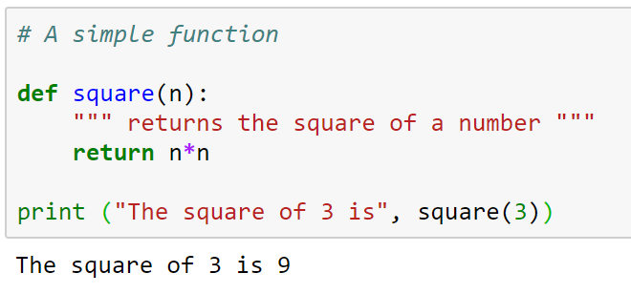
Functions
Function definitions can contain any control structure you like.
Ex: when square is called, the 3 is copied into the parameter n, before executing the body
Remember the Terminology:
n is the parameter
3 is the argument (the value we give the parameter this time)
A function sends a value (or values) back to the caller by returning it (or them)
Now when you call square(val), it prints the square of that val
Body of the function should be indented consistently (4 spaces is typical in Python;
Beware of tabs -- AVOID THEM)‏

Slide 11
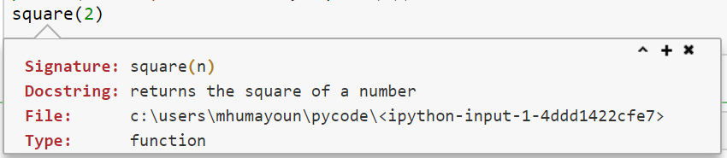
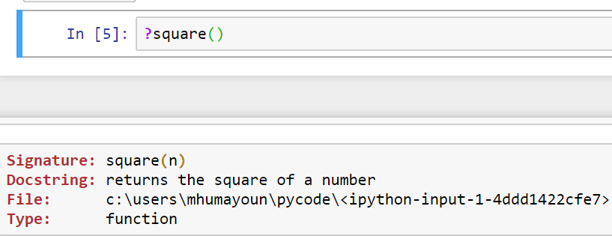
Docstring: Shift + Tab
Place your cursor inside function name and press “Shift+Tab”
Alternatively:

Slide 12
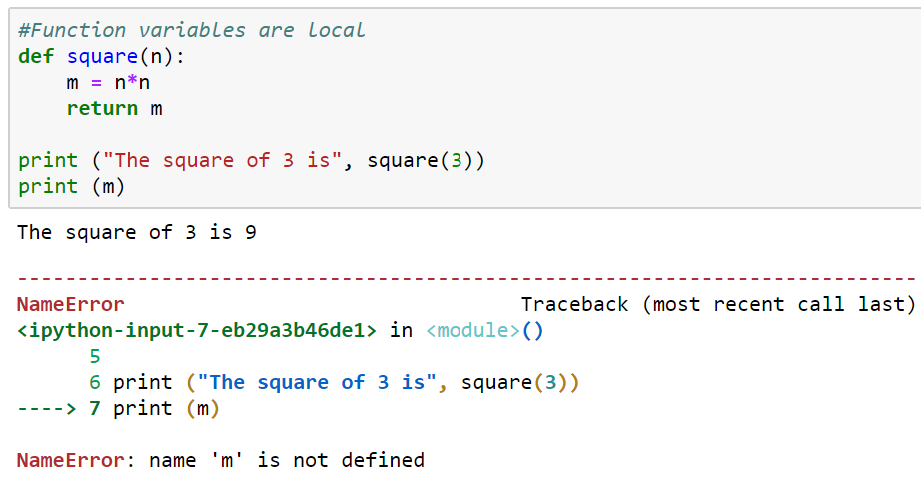
Function variables are local
Variables declared in a function do not exist outside that function
They are local
For example, m and n are local variables in square function
The locals only exist while the function is running
Lifetime or extent: the time during which a variable takes up memory
Variable is “born” when the function is initialized…
… and “dies” when the function it is in returns

Slide 13
Local variables
Other functions cannot see local variables at all!
The scope of the variable is which part of the code can see it
The scope of a local variable is the body of the function it is in, starting from its initialization
This means your function cannot refer directly to variables in other functions.
If you need access to information from another function
Use a parameter and argument to send information into a function
Use the return value to get information back out
A global variable is defined outside any function
Avoid these! Very hard to reason about, they can be changed by ANY function at ANY time!

Slide 14
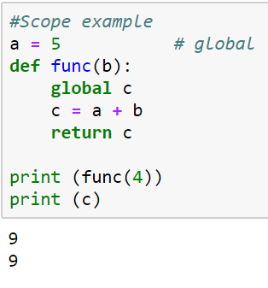
Scope example

Slide 15
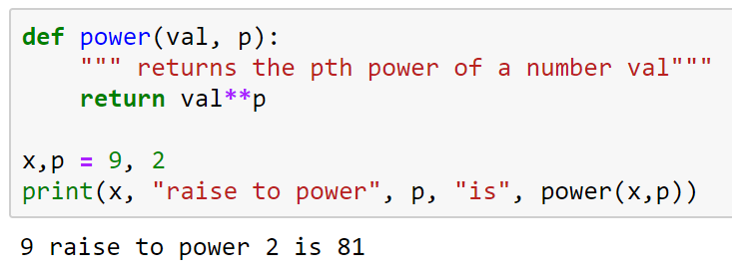
Functions with multiple parameters
Functions can have more than one parameter
When calling the function, you must supply the same number of arguments as parameters
power(5) #ERROR
power(5,3,4) #ERROR
If arguments are in wrong order, or if arguments are the wrong type, the function will eventually give an error
power(“Hello”, “this”) #ERROR

Slide 16
Functions without return values
All functions in Python return something.
If a return statement is not given, Python returns None
For example, the list append function changes the list but does not return a value:
a = [0, 1, 2] b = a.append(3) print (b)
Output
None

Slide 17
Parameters/return values vs. input/output
parameters take “input” from the statement that calls the function
return value send “output” to the statement that called the function
input() takes input from the keyboard (the user)
print() sends output to the screen (the user)
Good functions usually use parameters and return a value,
Good functions do not usually use input and print
Then you can use them not only with user input…
… but also with graphical programs, files, computed data…
When should a function use input or print?
When the function’s sole purpose is to interact with the user

